Slide 1

Intermediate PyTorch
©CounterFactual.AI LLC. All rights reserved. Do not distribute.

Slide 2
Agenda
 | Image Classification Convolutional Neural Networks

Slide 3
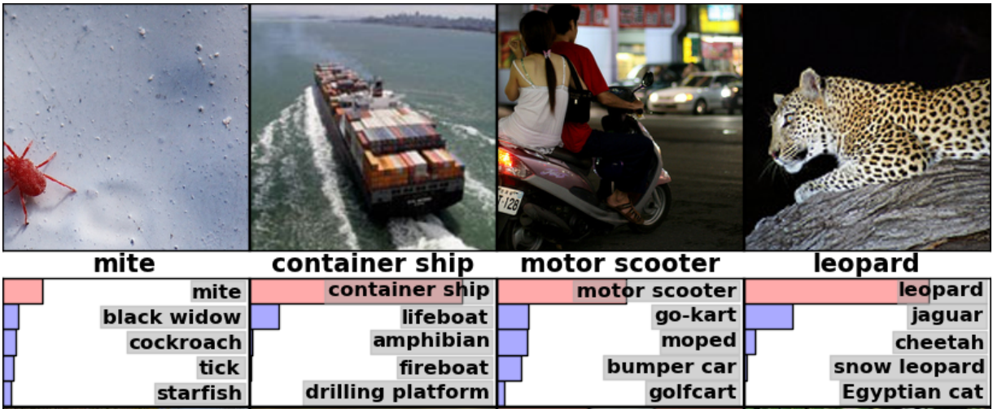
What is image classification?
Given in an input image, identify an object or objects of interest

Slide 4
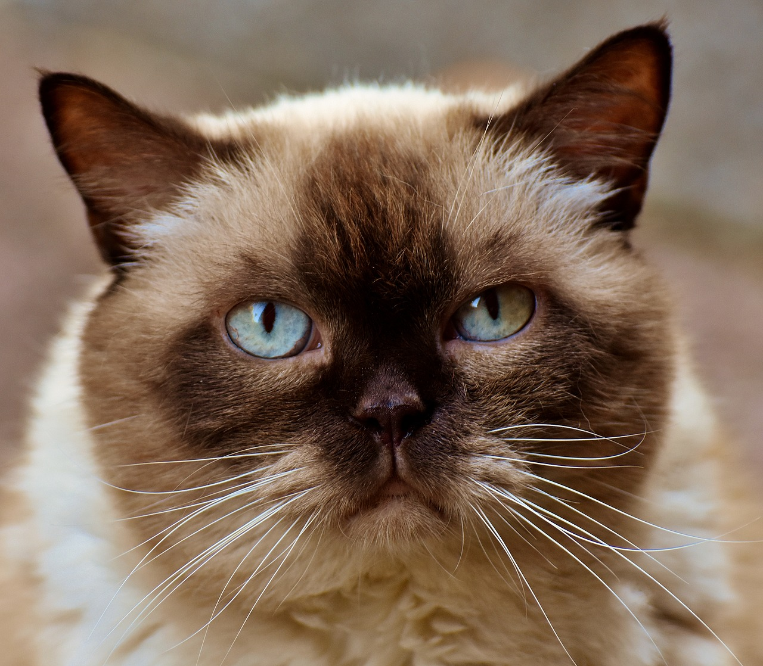

Traditional image classification pipeline
Traditional image classification tasks utilize a feature engineering step
Model
Input image | Feature engineering | Derive features (e.g., Harr Cascades) | Machine learning modeling

Slide 5
Deep neural networks showed dramatic improvements in areas such as image classification
Team | Year | Place | Error
XRCE | 2011 | 1st | 25.8%
Supervision (AlexNet) | 2012 | 1st | 16.4%
Clarifai | 2013 | 1st | 11.7%
GoogLeNet (Inception) | 2014 | 1st | 6.7%
Andrej Karpathy (human) | 2014 | N/A | 5.1%
BN-Inception (Arxiv) | 2015 | N/A | 4.9%
Inception-v3 (Arxiv) | 2015 | N/A | 3.5%
Source: Rethinking the Inception Architecture for Computer Vision

Slide 6
With training deep neural networks can discover higher order features
Manual feature engineering steps are not required
Input image | Feature engineering AND modeling

Slide 7
A dense (fully-connected layer) is full 😃 of weights
For large, real-world image datasets the number of weights grows very quickly
Example: 8 megapixel camera, 100 neurons in the first hidden layer
~24 million pixels times 100 units
= 2.3 billion parameters just in the first layer!
...
...

Slide 8
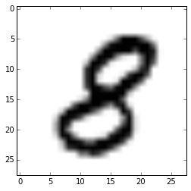
Convolutional neural networks (CNNs) have advantages for image analysis over dense networks
Input image | Convolutional layers | Pooling layers | Output layers
....
...

Slide 9
Convolution is a standard image processing operation that involves a constant-size filter

Slide 10

The layer generated by the convolutional layer is computed by the filter moving across an input
CNNs apply convolution across the input using a sliding window
with a specific stride

Slide 11
Dimensionality reduction decreases the total # of parameters and computation time
stride=2
Larger strides decrease dimensionality
Stride controls how far we slide the convolution filter
However, just skipping pixels is problematic because it is arbitrary

Slide 12
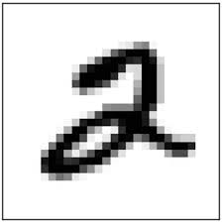
In neural network terms, convolution is a set of shared weights that can be learned; they emphasize spatial proximity
Filter1
A convolutional layer consists of multiple filters where each filter applies a unique convolution to the input
W1
Filter2
W2

Slide 13
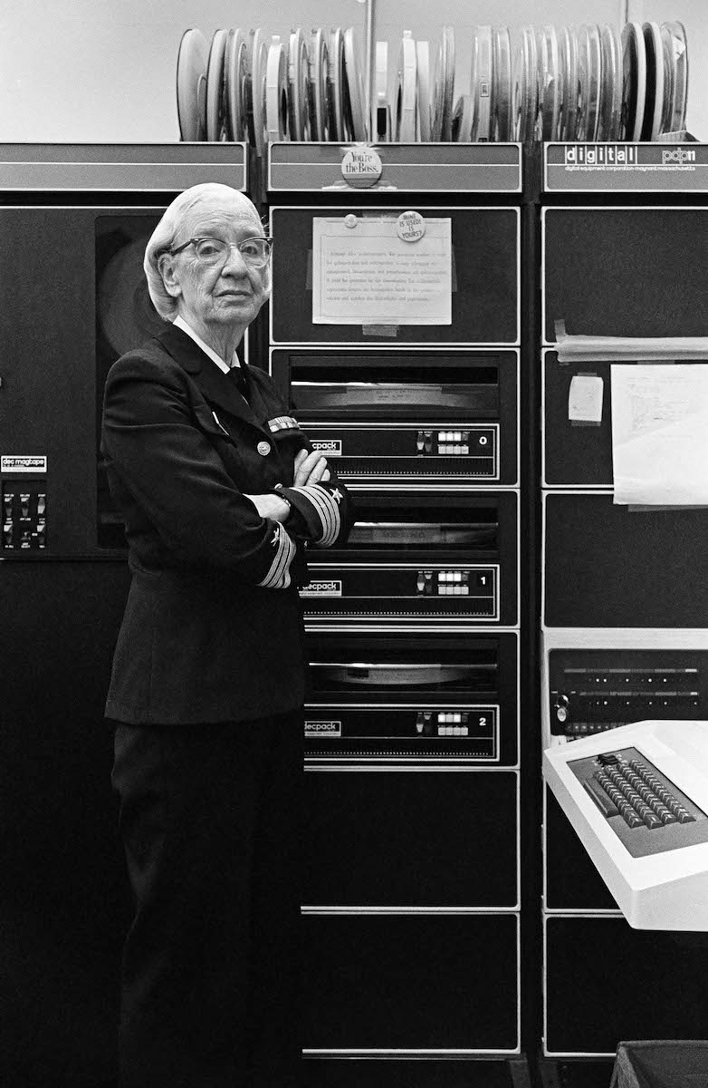
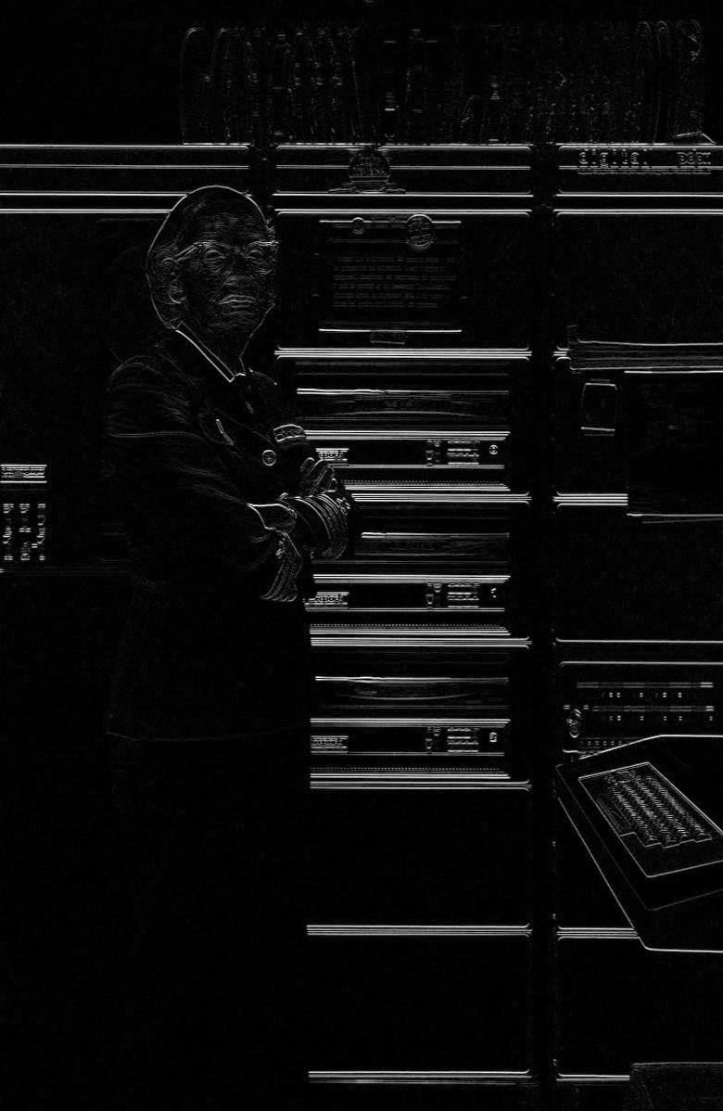
Different weights detect different features
1 2 1 0 0 0 -1 -2 -1
Notes:
https://commons.wikimedia.org/wiki/File:Grace_Murray_Hopper,_in_her_office_in_Washington_DC,_1978,_%C2%A9Lynn_Gilbert.jpg

Slide 14
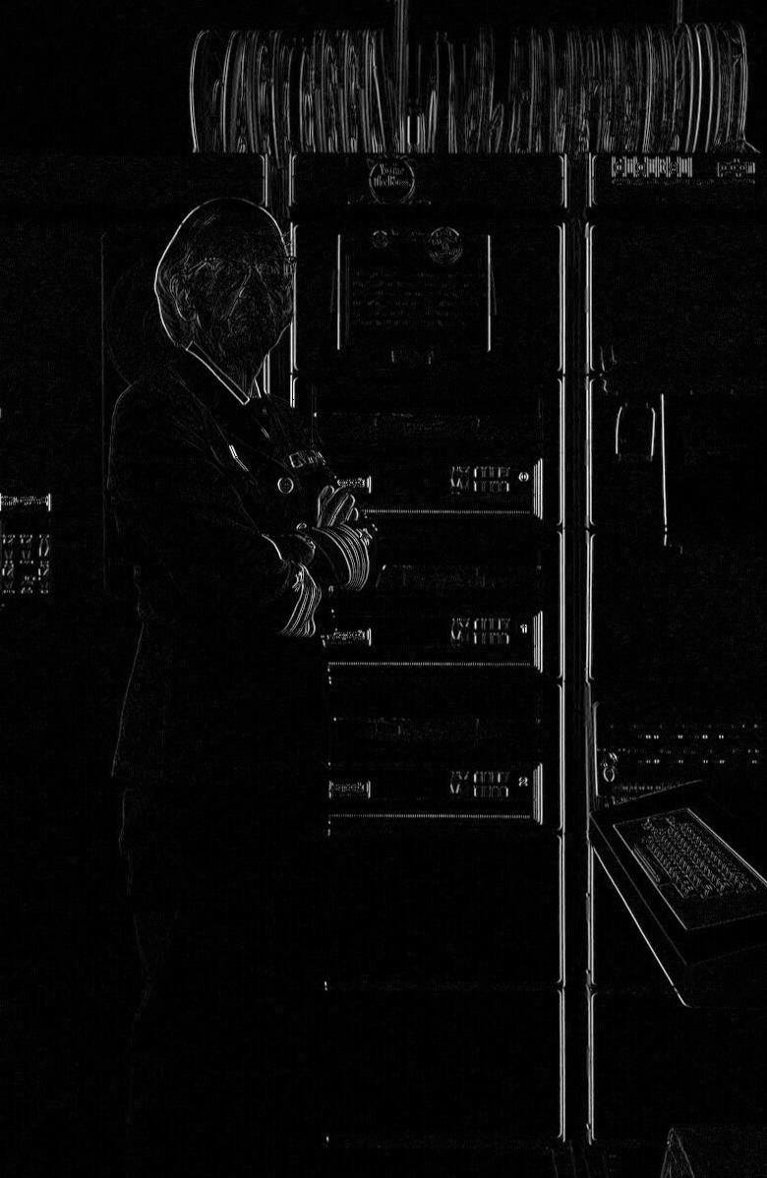
Different weights detect different features
1 0 -1 2 0 -2 1 0 -1
Notes:
https://commons.wikimedia.org/wiki/File:Grace_Murray_Hopper,_in_her_office_in_Washington_DC,_1978,_%C2%A9Lynn_Gilbert.jpg

Slide 15
Toy example using edge detection kernels
W1
Horizontal edge filter
1 2 1 0 0 0 -1 -2 -1
Filter1
Two possible convolution kernels W1 and W2: a horizontal edge detector and a vertical edge detector
In an actual CNN these weights are learned during training
W2
Filter2
1 0 -1 2 0 -2 1 0 -1
Vertical edge filter
Notes:
https://commons.wikimedia.org/wiki/File:Grace_Murray_Hopper,_in_her_office_in_Washington_DC,_1978,_%C2%A9Lynn_Gilbert.jpg
Note: the network likely won’t learn these exact filters, but they demonstrate potential filters that could be learned.

Slide 16
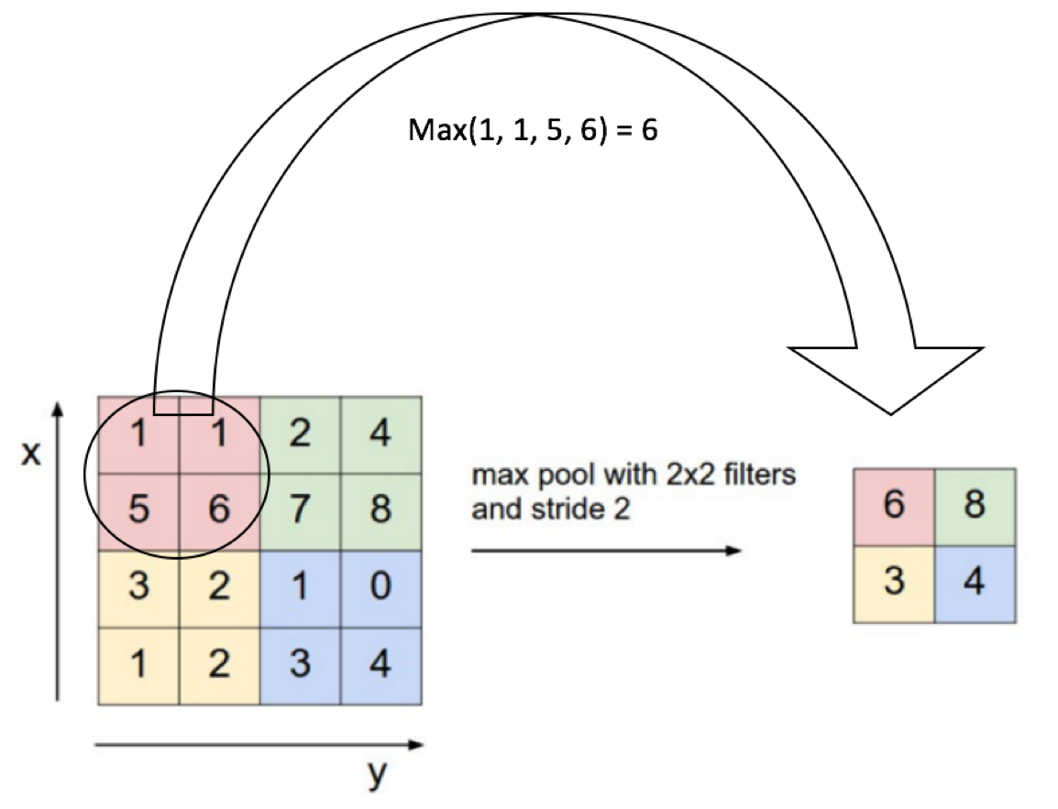
Maxpooling reduces the shape
4x4
2x2

Slide 17

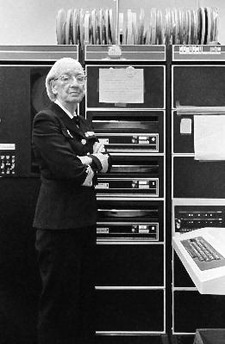
Maxpooling example
Maxpool
Kernel: 2x2
Stride: 2
Dimensionality is decreased by a factor of 2 both horizontal and vertically
Brighter values correspond to larger pixel values
Notes:
https://commons.wikimedia.org/wiki/File:Grace_Murray_Hopper,_in_her_office_in_Washington_DC,_1978,_%C2%A9Lynn_Gilbert.jpg

Slide 18
Successive convolution layers apply filters to increasing scales
28x28x1
convolutional layer, 4-deep W1[5, 5, 1, 4] stride 1
28x28x4
convolutional layer, 8-deep W2[4, 4, 4, 8] stride 2
14x14x8
convolutional layer, 12-deep W3[4, 4, 8, 12] stride 2
7x7x12
200
fully connected layer W4[7x7x12, 200]
softmax readout layer W5[200, 10]
10

Slide 19
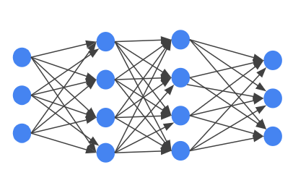
Dropout for regularization; also neural net ensembling
At every training step, each neuron has a probability of being temporarily “dropped out” so its weights are ignored for calculations
From another point of view, for each training step a unique neural network is generated
Accordingly, the final neural network can be described as an averaging ensemble of many different networks

Slide 20
Demo: Convolutional NN

Slide 21
Agenda
 | Data Augmentation Batch Normalization Transfer Learning

Slide 22
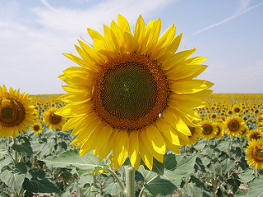
FashionMNIST is gray-scale … what about “real” images?
More channels (RGB)
Input format different (JPEG)
Different classes (daisy, sunflowers, etc.)
Sunflowers by Liz West is licensed under CC BY 2.0

Slide 23
Color images are represented by a 3D matrix of RGB values
R
G
B
a_{1,1} a_{1,2} a_{1,3} ...
a_{2,1} a_{2,2} a_{2,3} ...
a_{3,1} a_{3,2} a_{3,3} ...
. . .
. . .
. . .
Sunflowers by Liz West is licensed under CC BY 2.0

Slide 24
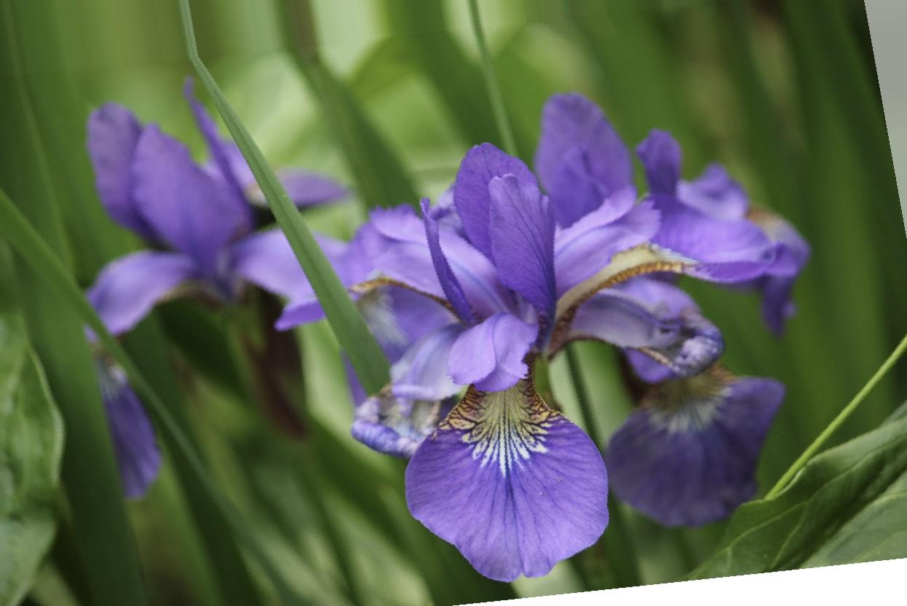
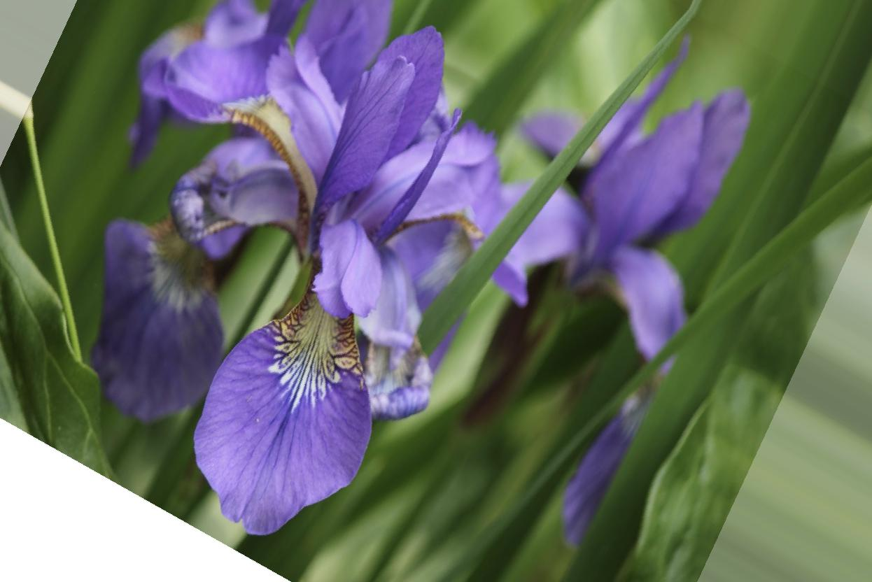
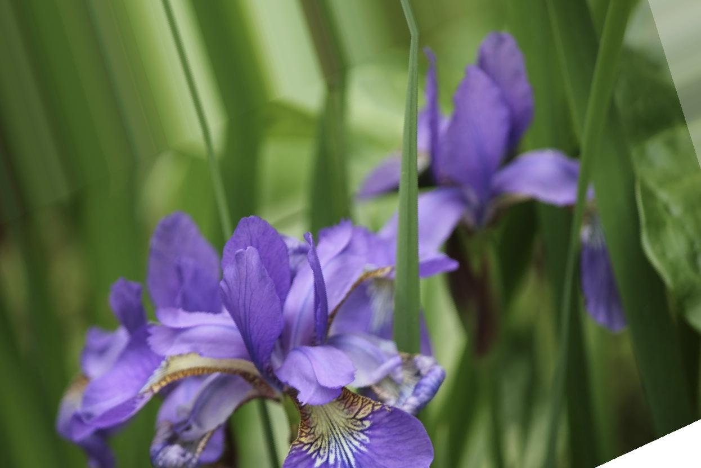
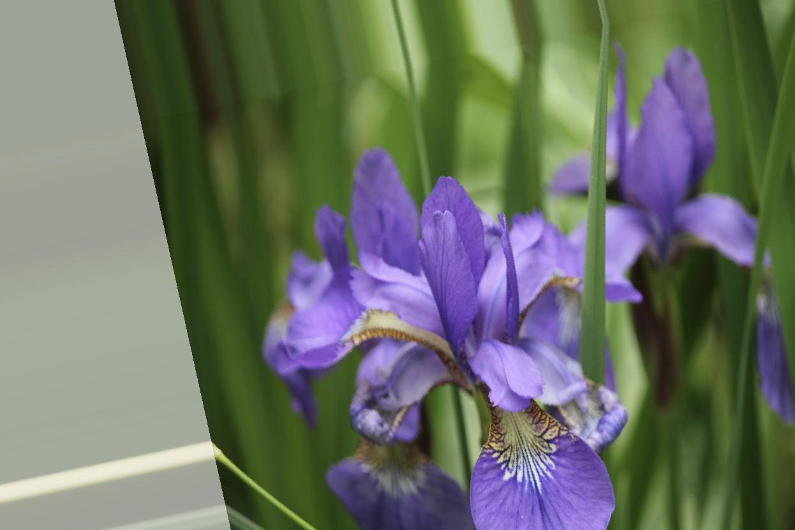
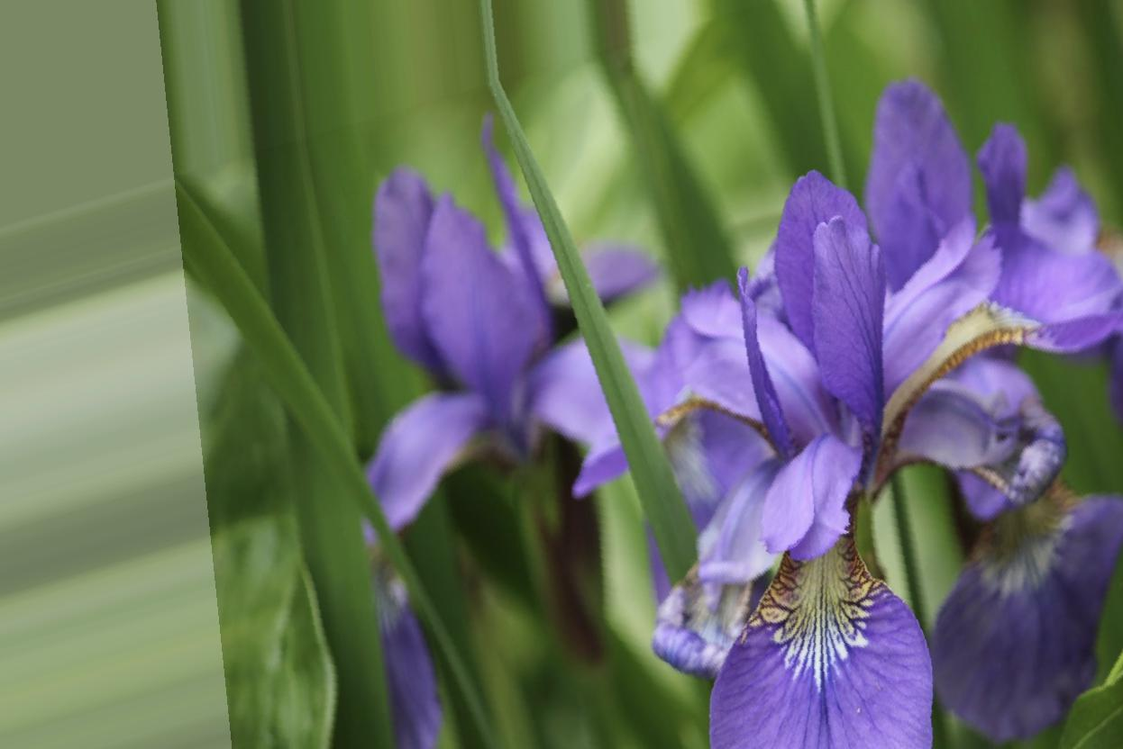
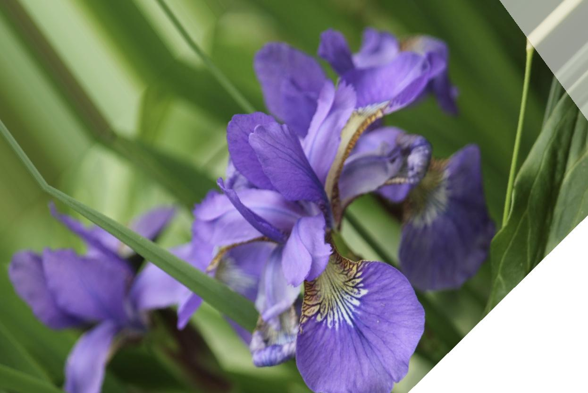
One way to “create” new data is to expand our dataset with transformations of the original images
Notes:
https://pixabay.com/en/iris-flower-purple-floral-spring-2327712/
https://www.freeonlinephotoeditor.com/

Slide 25

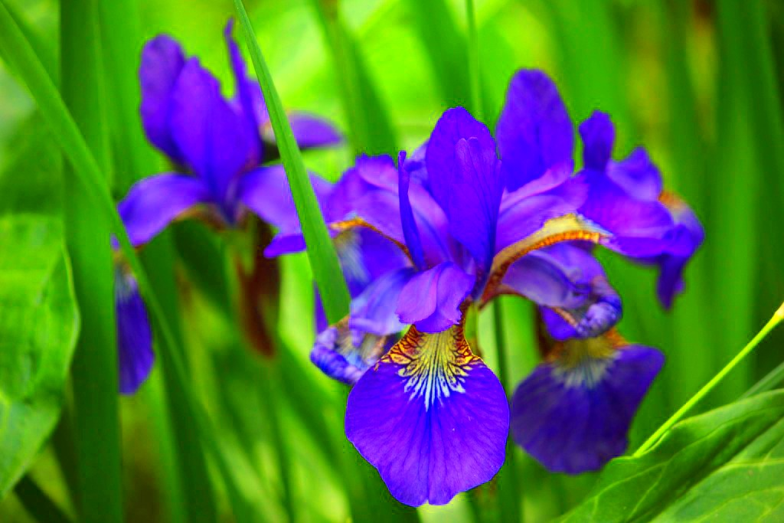
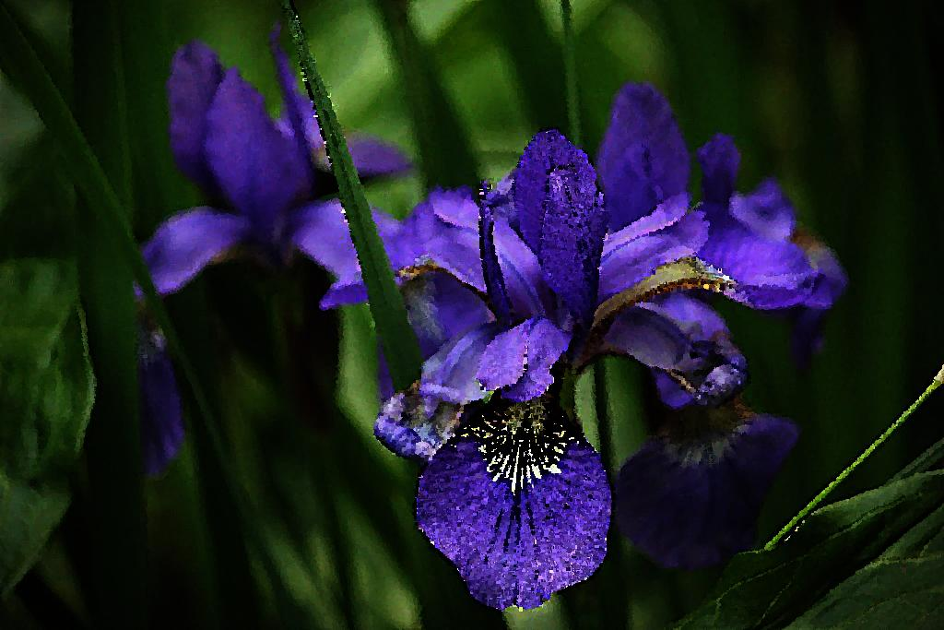
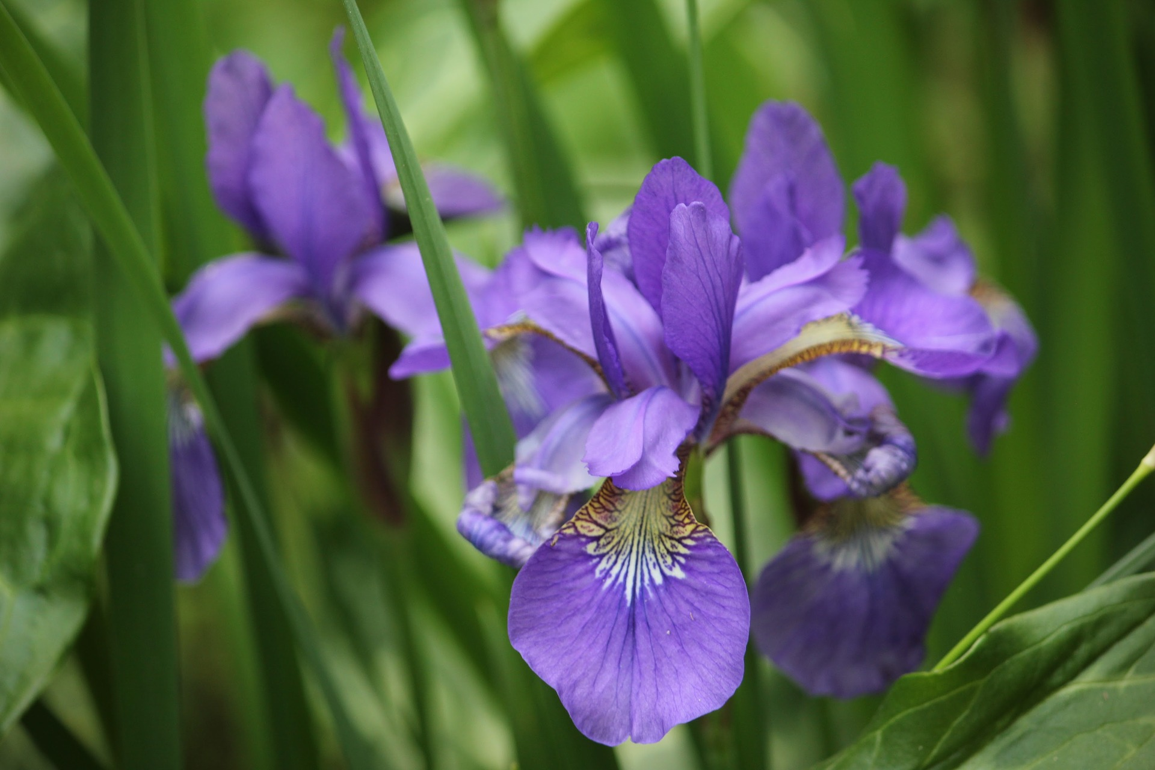

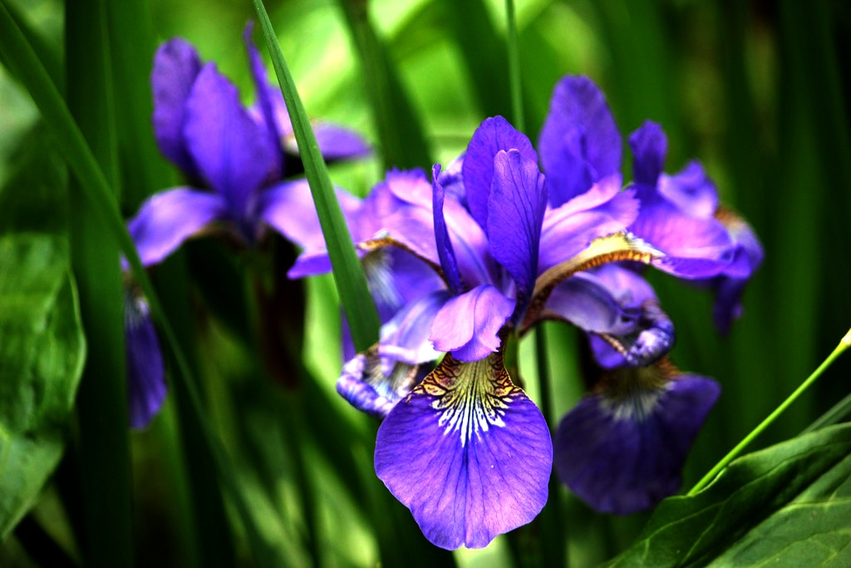
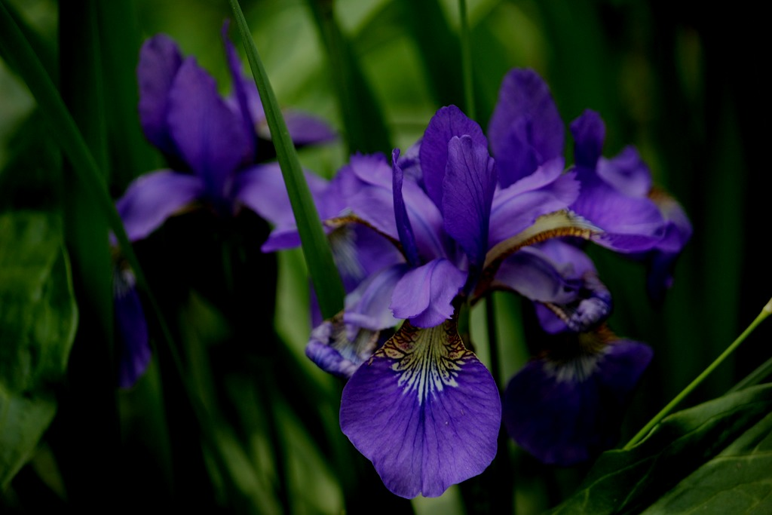
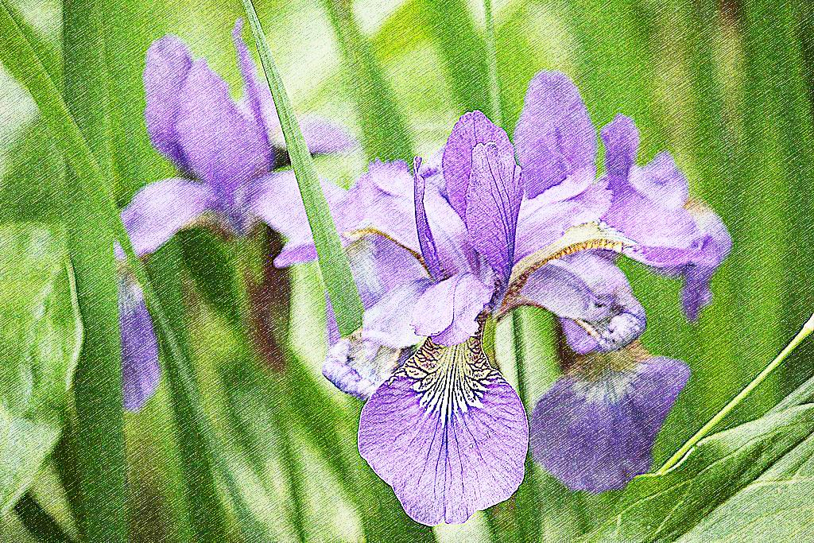
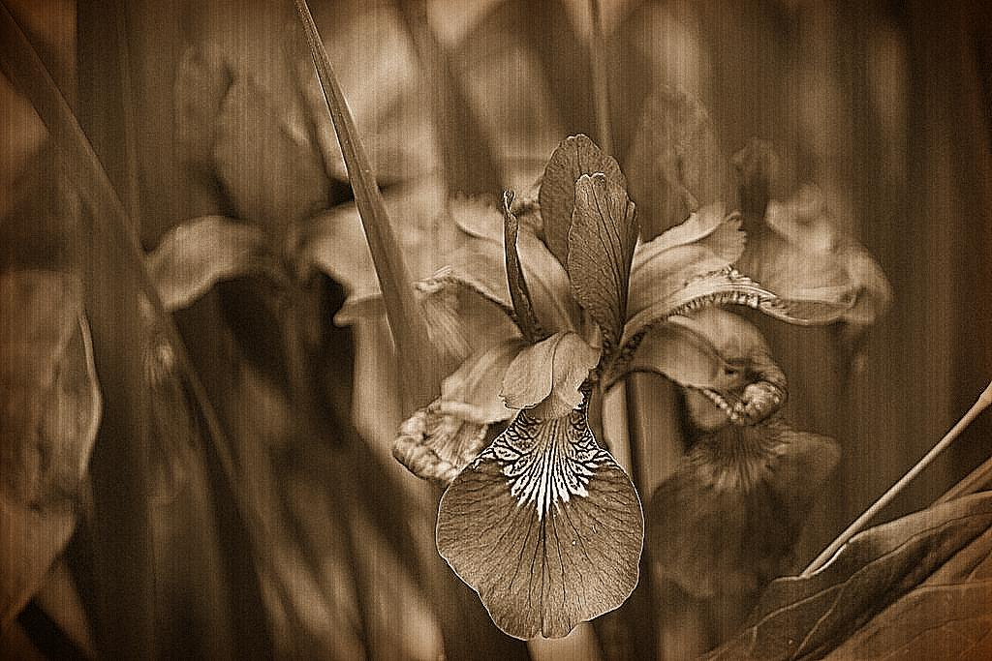

Do you think augmenting images by changing brightness/contrast will help for this iris flowers dataset?

Slide 26
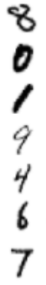
The moving average and variance need to be computed during training; during inference, the learned averages are used to normalize
Batch normalization to accelerate optimization
batch
Hidden
Layer 1
Hidden
Layer 2
Hidden
Layer 3
Output
Normalize each layer using batch statistics
Notes:
Also, you have to make sure that the moving averages are computed during training. Hence, the dependency in the training_loss
(for dropout, there is nothing to compute during training, so this was not needed)

Slide 27
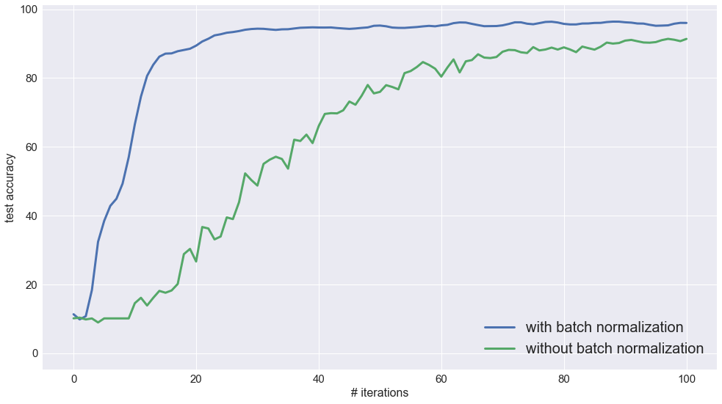
Batch norming increases speed of convergence
Training with fewer iterations
7 layers, fully connected
ReLU activations

Slide 28
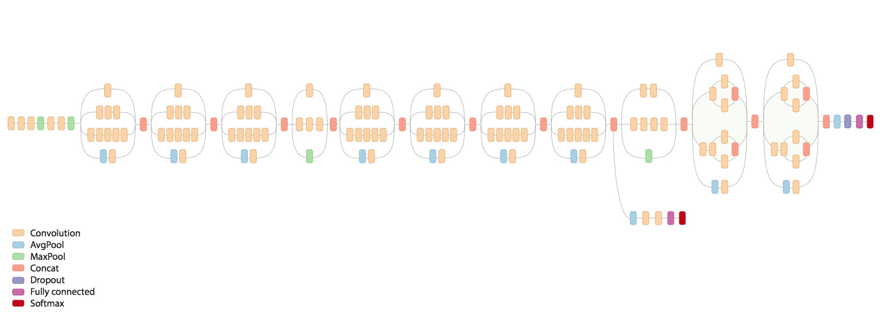
An actual image classification network
28
Inception v3 http://arxiv.org/abs/1512.00567

Slide 29
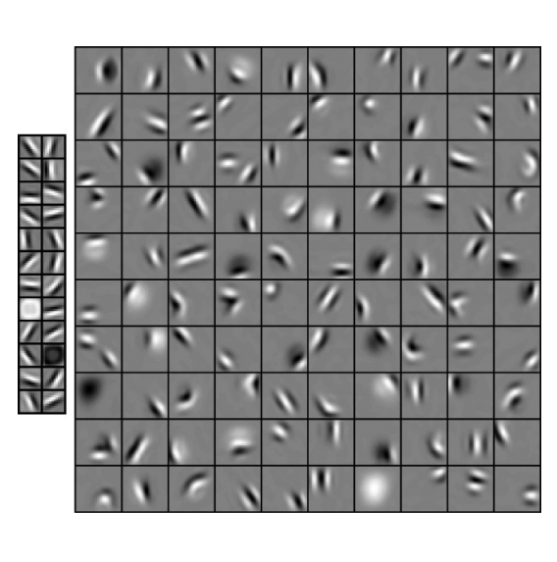
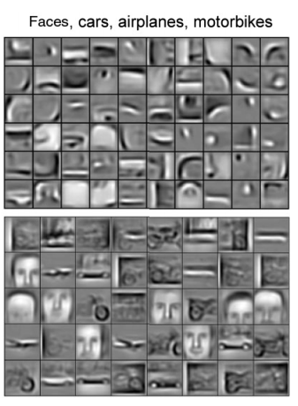
Fortunately, the first layers are reusable
. . .
Images from http://www.cs.toronto.edu/~rgrosse/cacm2011-cdbn.pdf

Slide 30
Avoid training a deep network from scratch
Transfer learning: reuse lower layers of a pre-trained network
pretrained model
fix early layers’ weights
retrain final layers
Faster convergence and less data

Slide 31
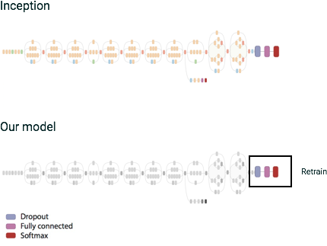

Custom image classification through transfer learning
reasonable accuracy without millions of images?

Slide 32
Demo: Transfer Learning

Slide 33
Exercise: Transfer Learning

Slide 34
Agenda
 | Embeddings Wide-and-deep Models

Slide 35
Word Embeddings

Slide 36
One-hot encodings typically arbitrary
Arbitrary position
One-hot
Marie Curie
Tiger Woods
Albert Einstein
Barack Obama
Larry Page
Angela Merkel
Usain Bolt
...
1
2
3
4
5
6
7
.
1000000
0100000
0010000
0001000
0000100
0000010
0000001
...

Slide 37
Ideal encodings are dense and clustered
Marie Curie
Tiger Woods
Albert Einstein
Barack Obama
Larry Page
Angela Merkel
Usain Bolt
...
1 1 0 ...
0 0 1 ...
0 1 1 ...
0 0 1 ...
0 0 1 ...
1 0 0 ...
0 0 0 ...
“woman”, “scientist”, “American” ...
How can such embeddings be created automatically?

Slide 38
Creating embeddings: Three ways
Count number of co-occurences of each pair e.g., (Albert Einstein, Marie Curie)
Embedding of words to vectors
Dataset of documents
ML model to predict likelihood of observing Werner Heisenberg in a document given whether Marie Curie, Albert Einstein, etc. appear
ML model to predict the likelihood of any specific set of words in a document

Slide 39
Also relevant to predicting sequences
Input1
Input2
Input3
Input4
Input5
Input1
Input2
Input3
Input4
Input5
Input1
Input2
Input3
Input4
Input5
Input1
Input2
Input3
Input4
Input5
Sales tomorrow
day-4
day-3
day-2
day-1
The embedding of day-4 ... day-2 inputs could be the prediction from yesterday!

Slide 40
Two types of features: Dense & sparse
{ "transactionId": 42, "name": "Ice Cream", "price": 2.50, "tags": ["cold", "dessert"], "servedBy": { "employeeId": 72365, "waitTime": 1.4, "customerRating": 4 }, "storeLocation": { "latitude": 35.3, "longitude": -98.7 } },
price 8345 72345 87654 98723 wait
2.50 0 1 0 0 1.4
40

Slide 41
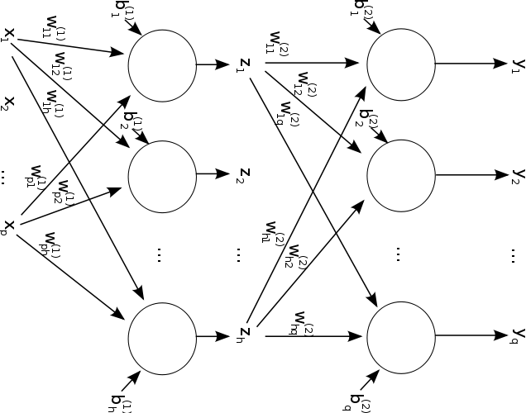

DNNs good for dense, highly correlated
pixel_values (
)
1024² input nodes
10 hidden nodes -> 10 image features

Slide 42
Linear for sparse, independent features
[ 0. 1. 0. 0. 0. 0. 0. 0. 0. 0.] [ 0. 0. 0. 0. 0. 0. 0. 1. 0. 0.] [ 0. 0. 0. 0. 0. 0. 0. 0. 0. 1.] [ 0. 1. 0. 0. 0. 0. 0. 0. 0. 0.] [ 0. 0. 0. 0. 0. 0. 0. 1. 0. 0.] [ 0. 0. 0. 1. 0. 0. 0. 0. 0. 0.] [ 0. 0. 0. 0. 0. 0. 1. 0. 0. 0.] [ 0. 1. 0. 0. 0. 0. 0. 0. 0. 0.] [ 0. 0. 0. 0. 1. 0. 0. 0. 0. 0.] [ 0. 1. 0. 0. 0. 0. 0. 0. 0. 0.]

Slide 43
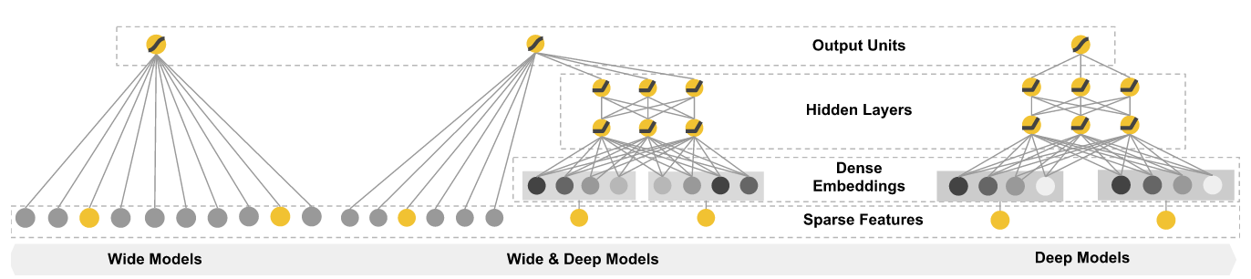

Can you have your cake & eat it too?

